Slide 1

WEB REPORTING
Uppwise Analytics

Slide 2
Table of Contents
Configure Design Settings.
Report Controls.
Shape Report Data.
Add Navigation
Bookmarks,
Doc Map
Table of content

Slide 3
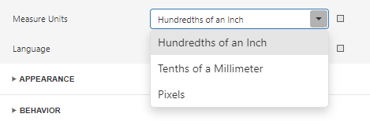
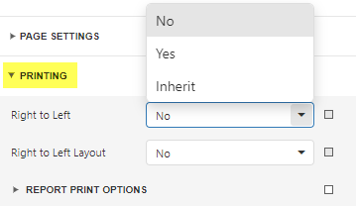
Configure Report Design
Change a Report’s Measurement Units
To switch your reports between using the imperial (hundredths of an inch)
or metric system (tenths of a millimeter) or Screen Coordinates (Pixels) for
specifying the size and location of report elements.
Right – To - Left Support
To mirror your report layout for audiences using a right to left writing
system.

Slide 4
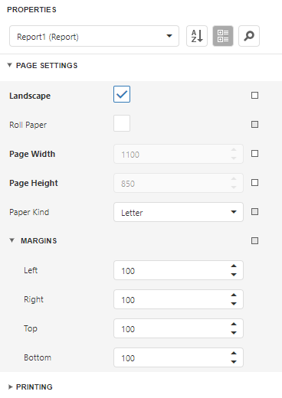
Configure Report Design
Change a Report’s Page Settings
You can use default printer settings or specify page settings in Report Designer.
You can choose Custom Paper Kind to create your own paper size.
These settings affect the report layout. After the settings change, you may notice red highlights which indicate that the controls go beyond the page width.

Slide 5
Reporting Elements
Basic Elements
Advance Elements
Label
Table
Character comb
Rich Text
Check Box
Picture box
Panel
Page Break
PDF content
Lines & Shapes
Sub report
Table of Contents
Page Info
Chart
Pivot
Barcodes
Gauges
Sparklines
Cross band lines

Slide 6
Reporting Elements
Label - Displays plain text in a report.
Rich Text - Displays rich text in a report. You can apply different font settings to the control's content and load content from an external HTML file.
Table - Contains any number of cells arranged in one or more rows. Each table cell can display plain text or contain other controls. (Static & Dynamic info).
Character Comb - Displays each character in a separate cell and can be used to create printed forms
Display Page Information - Use the Page Info control to display information about document pages, such as the current page number and/or total number of pages.
Check boxes - Check boxes can display different states depending on the underlying data values.

Slide 7
Reporting Elements
Picture Box – It allows you to embed static (stored with the report) or dynamic (obtained from a data source) images into a report.
Bar Code - To display bar codes, use the Bar Code control.
Drawing Lines and Shapes - Use the Shape control to draw simple graphics in a report (circles, crosses or arrows).
The Line control enables you to draw straight or slanted lines in a single band.
The Cross-Band Line and Box controls enable you to draw lines and boxes spanning multiple report bands
Panel – It is a container that frames separate report controls and allows you to move, copy and paste them.

Slide 8
Reporting Elements
Page Break – The sole purpose is to insert a page delimiter at any point within a report.
PDF Content – To render PDF file content into the report.
PDF Signature – It allows user to add a visual signature to a report exported to PDF.
Subreport - To embed other reports in a current report.
Page Info - The control is used to display auxiliary information on report pages, such as date, time, page numbers or username.
Charts – To display pictorial information.
Pivots – To display data in pivot grid.

Slide 9
Shape Report Data
Filter Data – To filter data at the report level as opposed to DS level using Filter Editor.
Group & Sort Data– To group & sort report data using Report Header.
Format Data – To specify value formatting for report elements using Text Format String.
Calculate Summaries - Calculate summaries in report.
Count Elements & Values – To Count data source values.
Use Calculated fields – To add custom fields to a report’s data source.
Use Report Parameters – To add parameter filters in report.

Slide 10
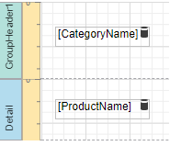
Steps to add Navigation in Report via Document Map & Bookmark
Add Data fields in Detail Band or Group Band as shown in image.
Go to Report’s Properties panel.
Expand Navigation section.
In Bookmark provide Title of Bookmark.
Select Data Field on which you want to apply bookmark. Ex. CategoryName, ProductName.
Goto CategoryName (Parent level) label Properties panel, Expand its Navigation section.
Bind Bookmark to your field CategoryName using Bookmark Expression editor.
Now Goto ProductName (Chil level) label Properties panel, Expand its Navigation section
Bind Bookmark to your field ProductName using Bookmark Expression editor.

Slide 11
Continue to Add Table of Contents
Set the same label's Parent Bookmark property to the label in the group band. That is CategoryName Go to Report’s Properties panel.
Add Report Header Band into the Report.
Drag & Drop control Table of Contents from toolbox to Report Header band.
Expand Behavior section from Properties of Table of contents control.
Provide Level Title & its appearance details.
Add Levels into LEVELS section & set its appearance settings, Symbol.
Save the report changes.
Preview report and see the result of changes you made.

Slide 12
Thank You.

